Slide 1


AGE 316
MICROCOMPUTER SYSTEMS
LECTURE 5: VARIABLES, DATA TYPES & CONTROL FLOW
Dr. Kadeghe Fue
Department of Agricultural Engineering

Slide 2


Recap: Lecture 4
Sketch Structure: The two required functions.
setup(): Runs once (Initialization).
void
setup
loop(): Runs forever (Main Logic).
void
loop
Syntax: Semicolons are mandatory!

Slide 3

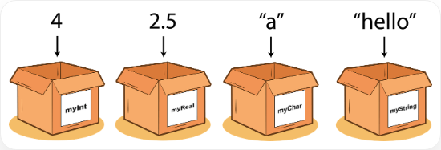

What is a Variable?
The "Box" Analogy
Imagine a variable as a storage box.
•
Name: The label on the box (e.g., myScore).
•
Value: What is inside the box (e.g., 10).
•
Type: The shape/size of the box (e.g., can it hold integers or text?).
Key Concept:
contents
label

Slide 4








Creating Variables
In C++, you must Declare a variable before you use it.
// Syntax: Type Name = Value;
int
ledPin
13
int
delayTime
1000
1. Type
2. Name
3. Value
What kind of data? (int)
The identifier. (ledPin)
The initial data. (13)

Slide 5

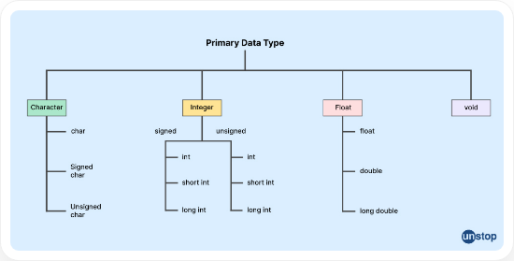







Data Types: The "Shapes" of Data
Computer memory is finite. Different data types use different amounts of space.

Slide 6





Numbers: Int vs. Float
int (Integer)
float (Floating Point)
Whole numbers only.
Numbers with decimals.
int
count
5
float
pi
3.14
int
temp
-10
float
temp
26.5
Range: -32,768 to 32,767 (on Uno)
Range: Huge, but less precise.

Slide 7

Logic & Characters
boolean (bool)
Holds only two values: true or false (1 or 0).
Example: bool isRunning = true;
char
A single character in single quotes.
Example: char grade = 'A';
String
Text string in double quotes (Technically an object, not a primitive).
Example: String msg = "Hello World";

Slide 8



Variable Scope: Global vs. Local
Where does it live?
int
globalVar
10
// Visible Everywhere
Global: Declared outside functions. Accessible by setup AND loop.
void
setup
int
localVar
5
// Only inside setup
Local: Declared inside a function (or block). Destroyed when the function ends.
void
loop
// Can use globalVar
// CANNOT use localVar
Tip:

Slide 9





Doing Math (Arithmetic)
+
-
*
/
Addition
sum = a + b;
Subtraction
diff = a - b;
Multiplication
prod = a * b;
Division
div = a / b;
Modulo Operator (%): Returns the remainder of division.
10 % 3 = 1 (Because 3 goes into 10 three times with 1 left over).

Slide 10
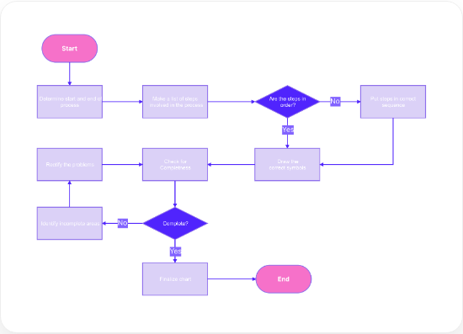
Control Flow: Making Decisions
So far, our code runs top-to-bottom.
Control Flow allows the program to make decisions:
•
"If the button is pressed, turn on the LED."
•
"If the temperature is too hot, turn on the fan."

Slide 11

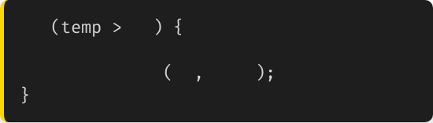
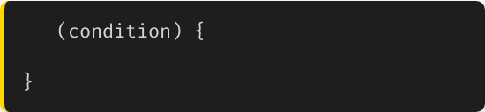
The 'if' Statement
Checks a condition. If TRUE, executes the code block.
if
30
if
// It's hot!
// Code to run if true
digitalWrite
13
HIGH

Slide 12


How to Compare?
Used inside the () of the if statement.
==
Equal to
!=
Not Equal to
>
Greater than
<
Less than
Warning:

Slide 13

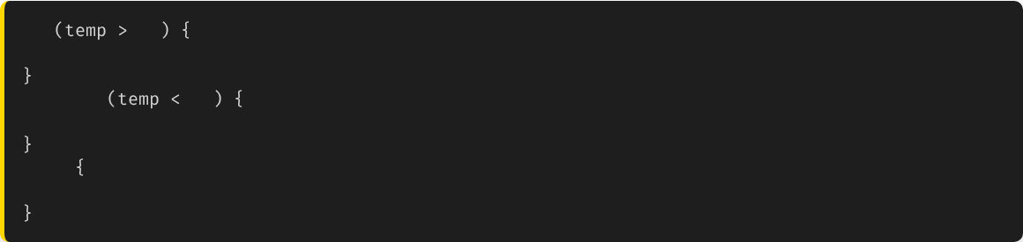
Else and Else If
if
30
// Turn on AC
else if
10
// Turn on Heater
else
// Do nothing, temp is fine
Allows you to handle multiple scenarios in a single logic block.

Slide 14




Logical Operators
Combine multiple conditions.
&&
||
!
AND
OR
NOT
True only if BOTH are true.
True if EITHER is true.
Inverts the value (True becomes False).

Slide 15

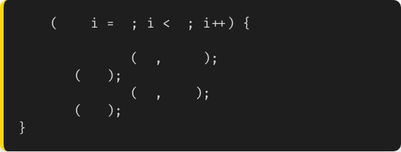
Loops: The 'for' Loop
Used to repeat a block of code a specific number of times.
Structure:
for
int
0
5
// Run this 5 times
1.
Initialize: Start counter (int i = 0)
digitalWrite
13
HIGH
delay
200
digitalWrite
13
LOW
2.
Condition: Stop when? (i < 5)
delay
200
3.
Increment: Count up (i++)

Slide 16

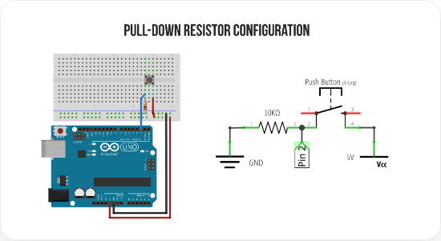

Practical: Button Toggle Logic
if
digitalRead
HIGH
digitalWrite
HIGH
else
digitalWrite
LOW
Connecting Logic to Hardware

Slide 17







Summary
Variables
Data Types
Flow
Named boxes to store data. Must declare Type.
int, float, bool define what data fits in the box.
if/else allows the code to make smart decisions.

Slide 18


Questions?
"The only stupid question is the one you don't ask."
Dr. Kadeghe Fue
Sokoine University of Agriculture

Slide 19





Image Sources
https://miro.medium.com/v2/resize:fit:1400/1*Px7h03Ih7B5QZu4KQpSEoQ.png
Source: studeappsblog.medium.com
https://d8it4huxumps7.cloudfront.net/uploads/images/6470889b81f66_data_types_in_c_3.jpg
Source: unstop.com
https://images.edraw.ai/blogs/general/banner-flowchart.png
Source: www.edraw.ai
https://makeabilitylab.github.io/physcomp/arduino/assets/images/ArduinoUno_Button_PullDownResistor_WiringDiagram.png
Source: makeabilitylab.github.io

